Slide 1

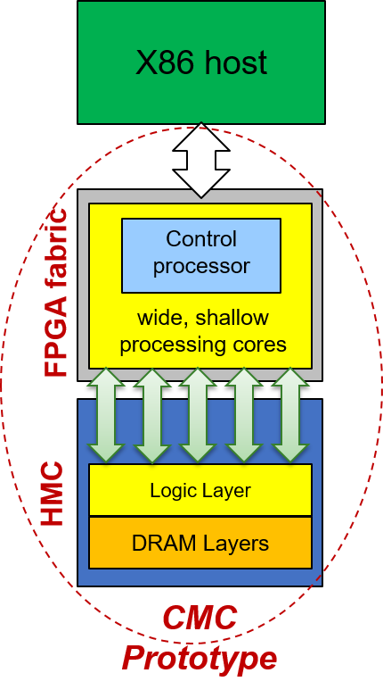
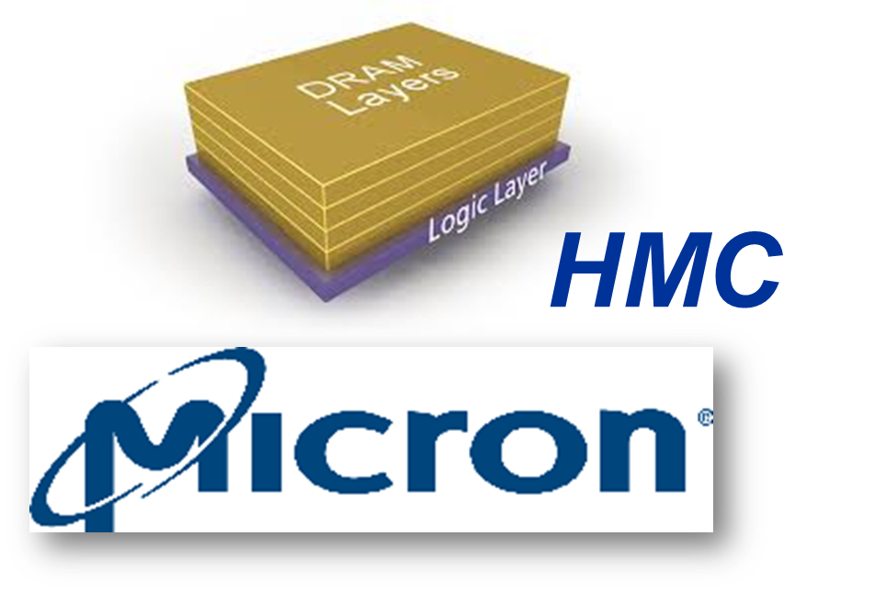
Custom Memory Cube (CMC)
Goal: Create research platform for design-space exploration CMC apps & arch (C-RAM* & PIM**)
Motivation:
Memory-intensive apps: memory bottleneck & high power consumption
HMC: higher B/W & lower power than current memories
Approach:
Create initial prototype of CMC arch using FPGA+HMC
Explore perf. measurement methods for CMC platform
Research perf. modelling for notional CMC architecture
Initial case study CMC app: DRE*** of LLNL
*C-RAM: Computational Memory **PIM: Processor in Memory
***DRE: Data Reordering/Rearrangement Engine

Slide 2
Custom Memory Cube (CMC)
Approach: Prototype CMC using FPGA/HMC boards
Performance of single memory operations (wr/rd)
Model of notional CMC**
Placeholder: to insert a result table
Performance of PageRank
Merlin board
Placeholder: to insert a result table
Nair, R., et al. "Active Memory Cube: A processing-in-memory architecture for exascale systems.“
IBM Journal of Research and Development 59.2/3 (2015): 17-1.

